Slide 1
Old Normalization

Slide 2
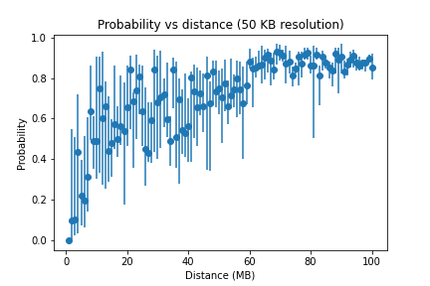
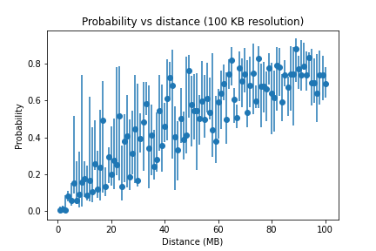
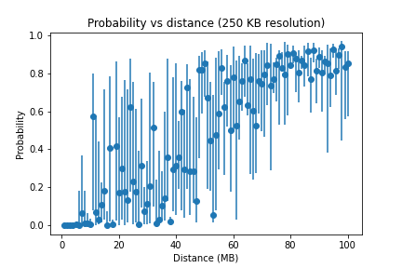
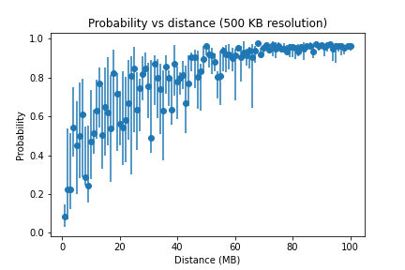
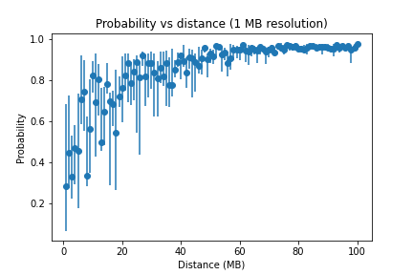

Slide 3
New Normalization

Slide 4
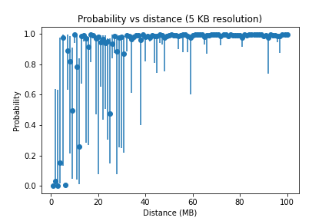
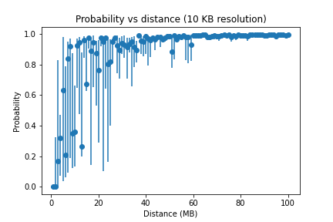
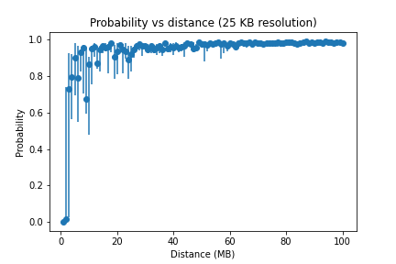
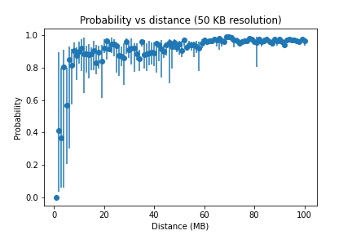

Slide 5
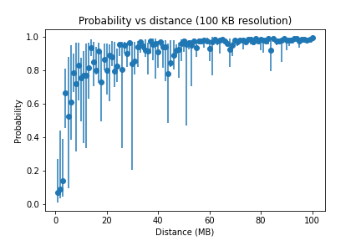
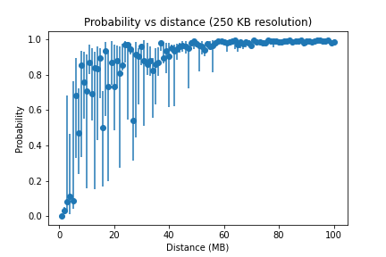
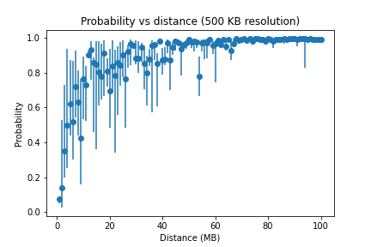
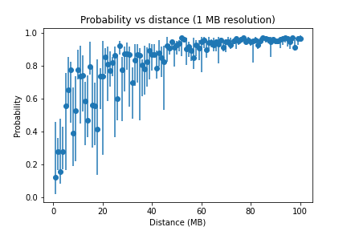

Slide 6
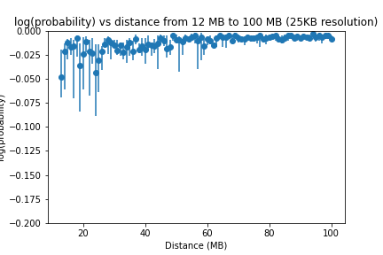
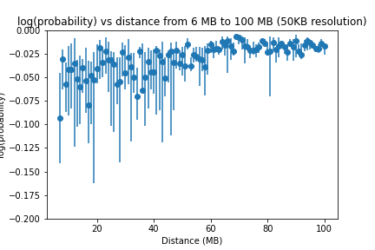
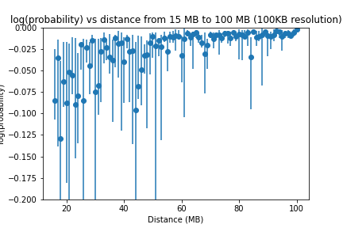
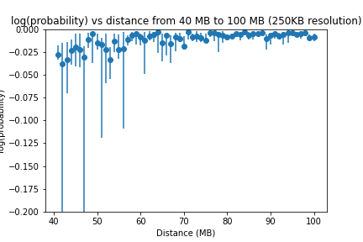
Notes:
Replot at the same scale

Slide 7
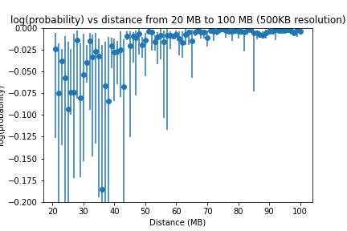
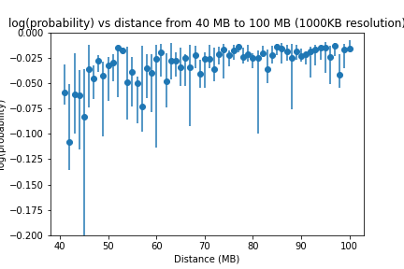

Slide 8
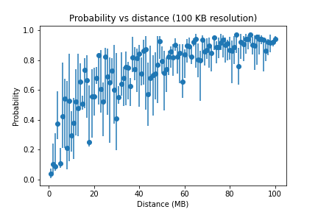

Slide 9
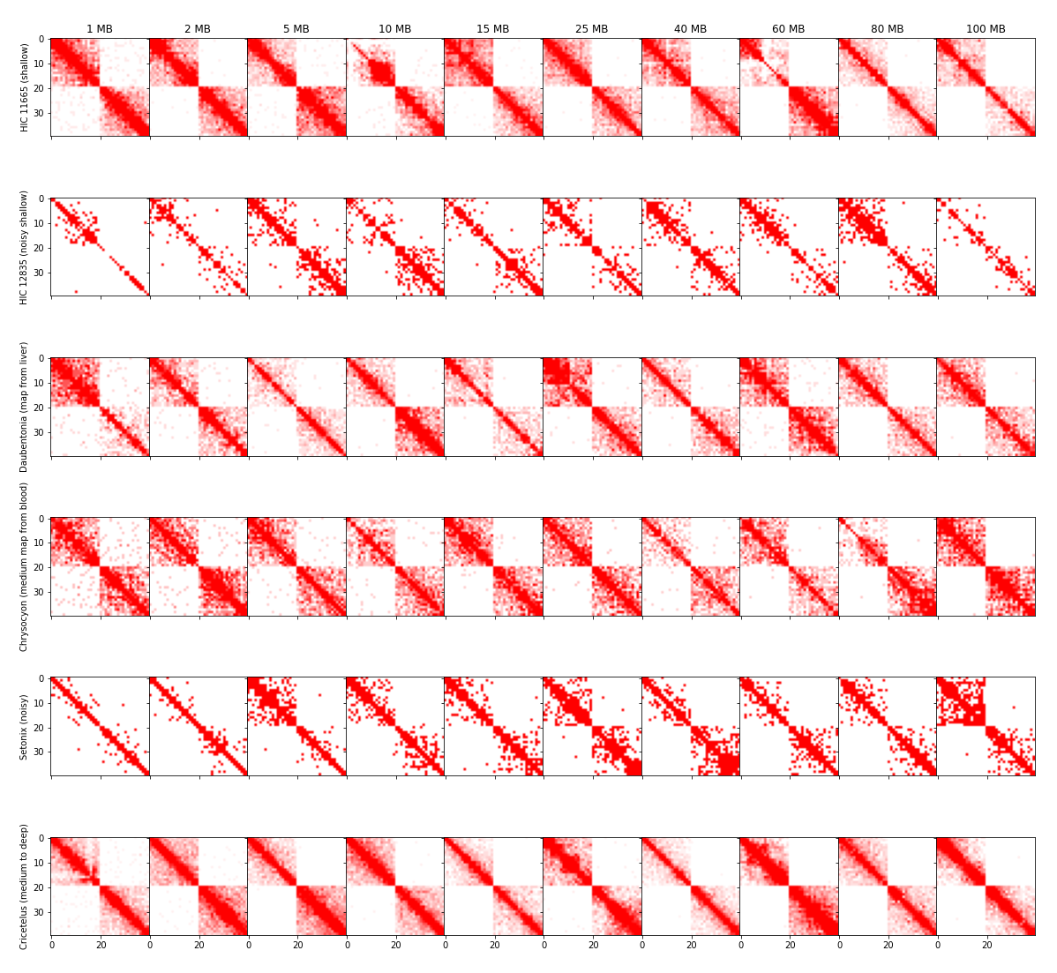
5 KB, 90% Centile, 40 by 40

Slide 10
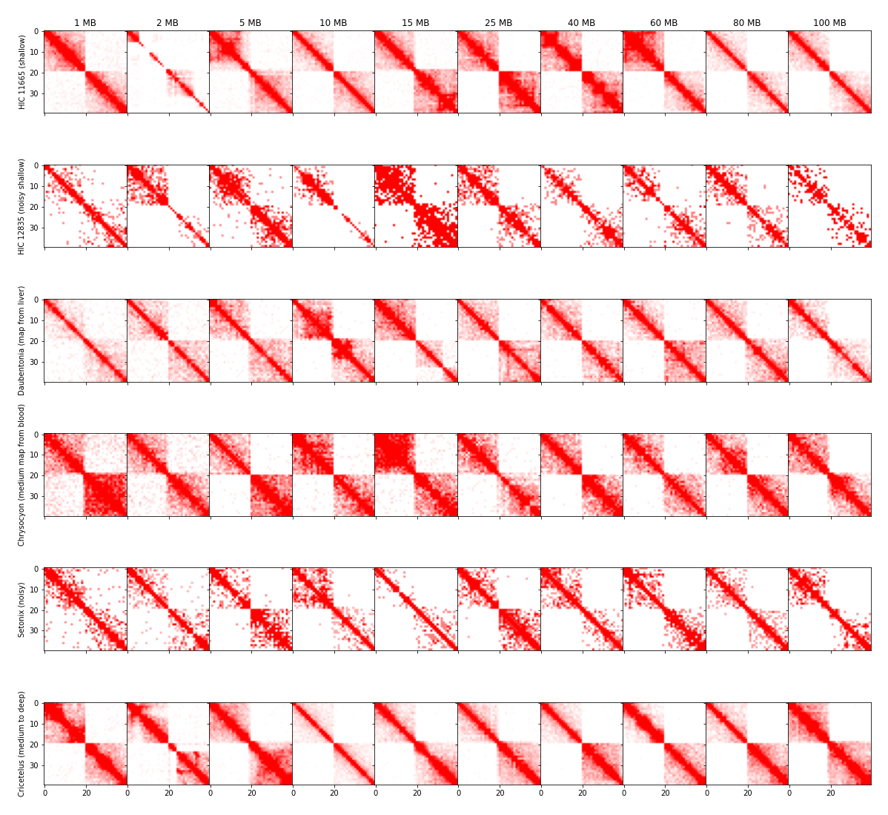
10 KB, 90% Centile, 40 by 40

Slide 11
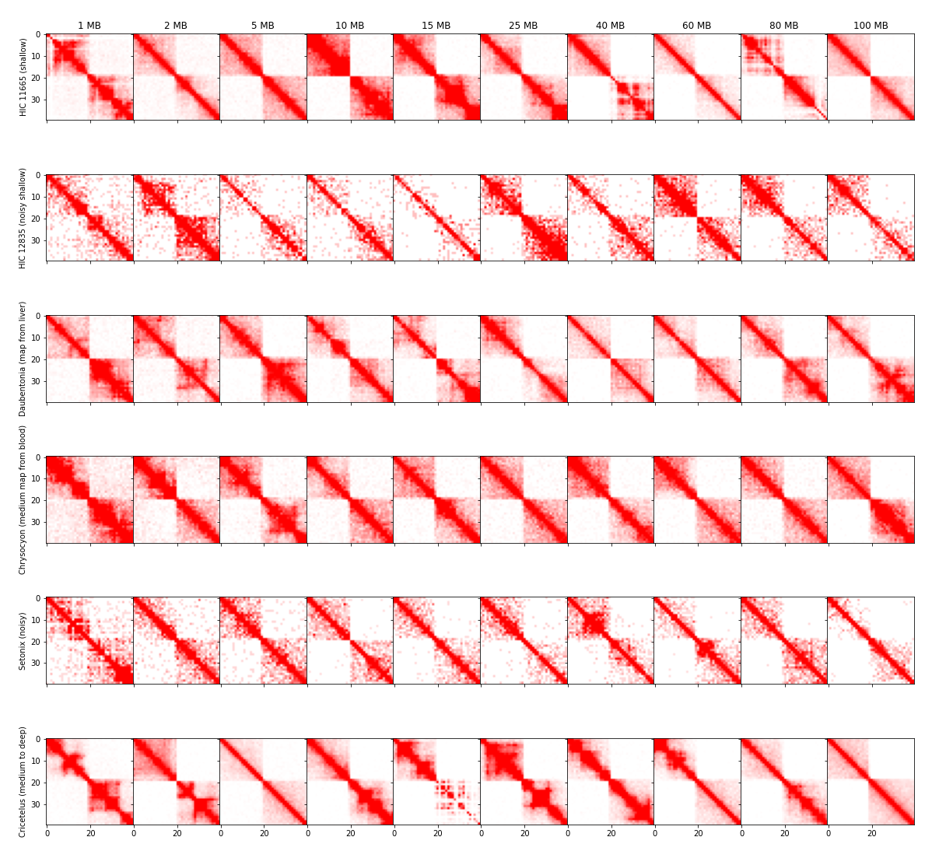
25 KB, 90% Centile, 40 by 40

Slide 12
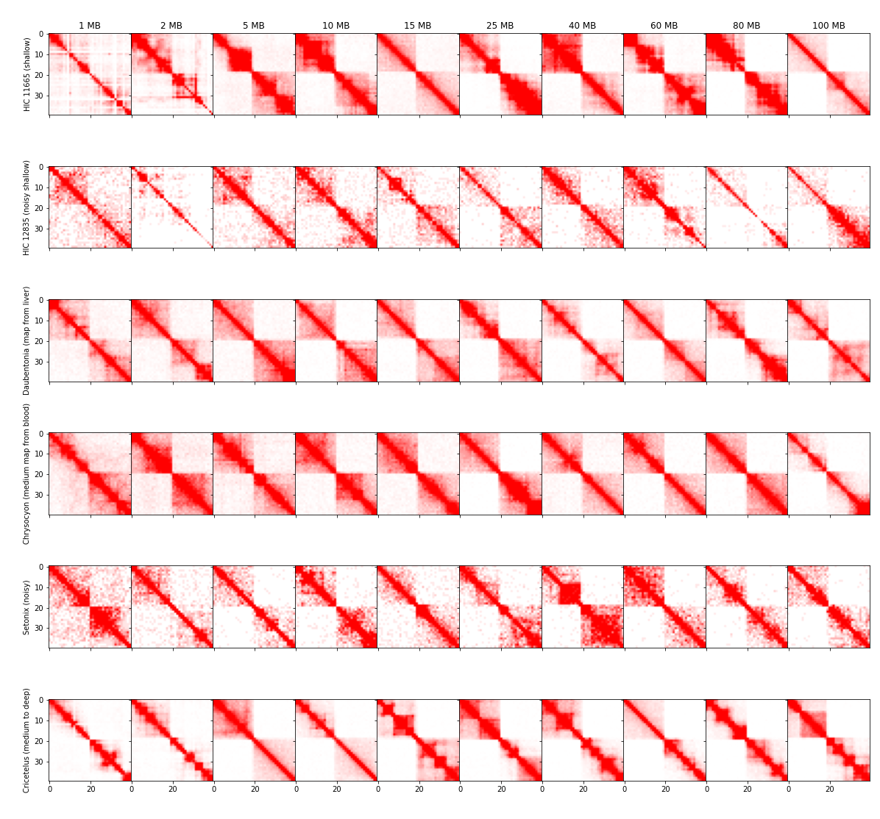
50 KB, 90% Centile, 40 by 40

Slide 13
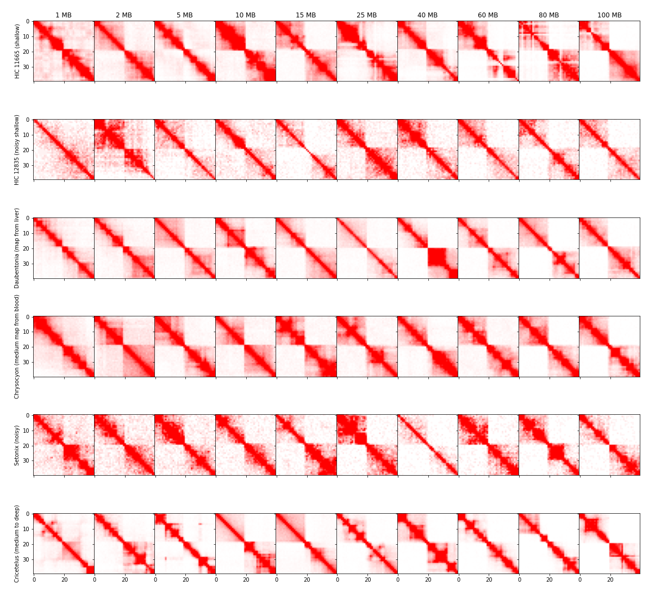
100 KB, 90% Centile, 40 by 40

Slide 14
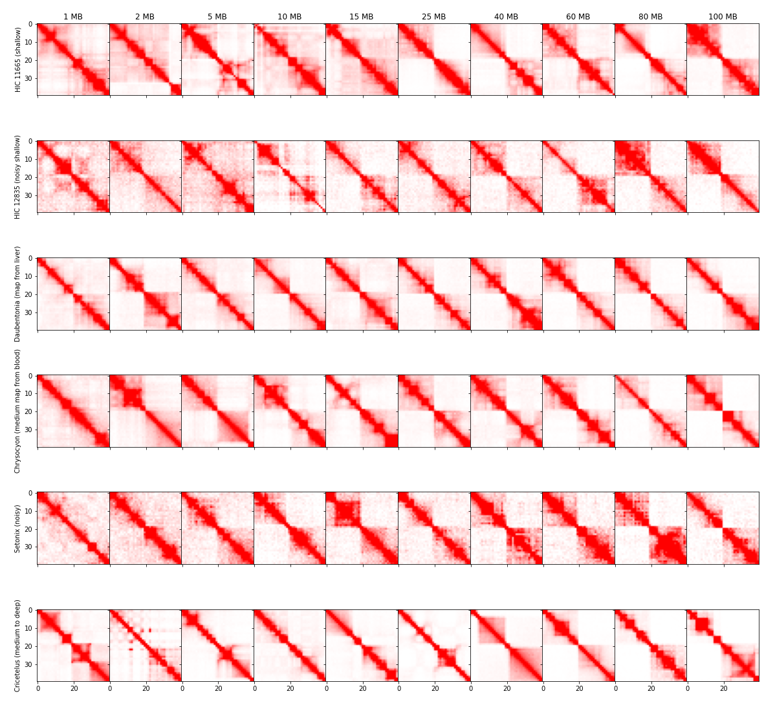
250 KB, 90% Centile, 40 by 40

Slide 15
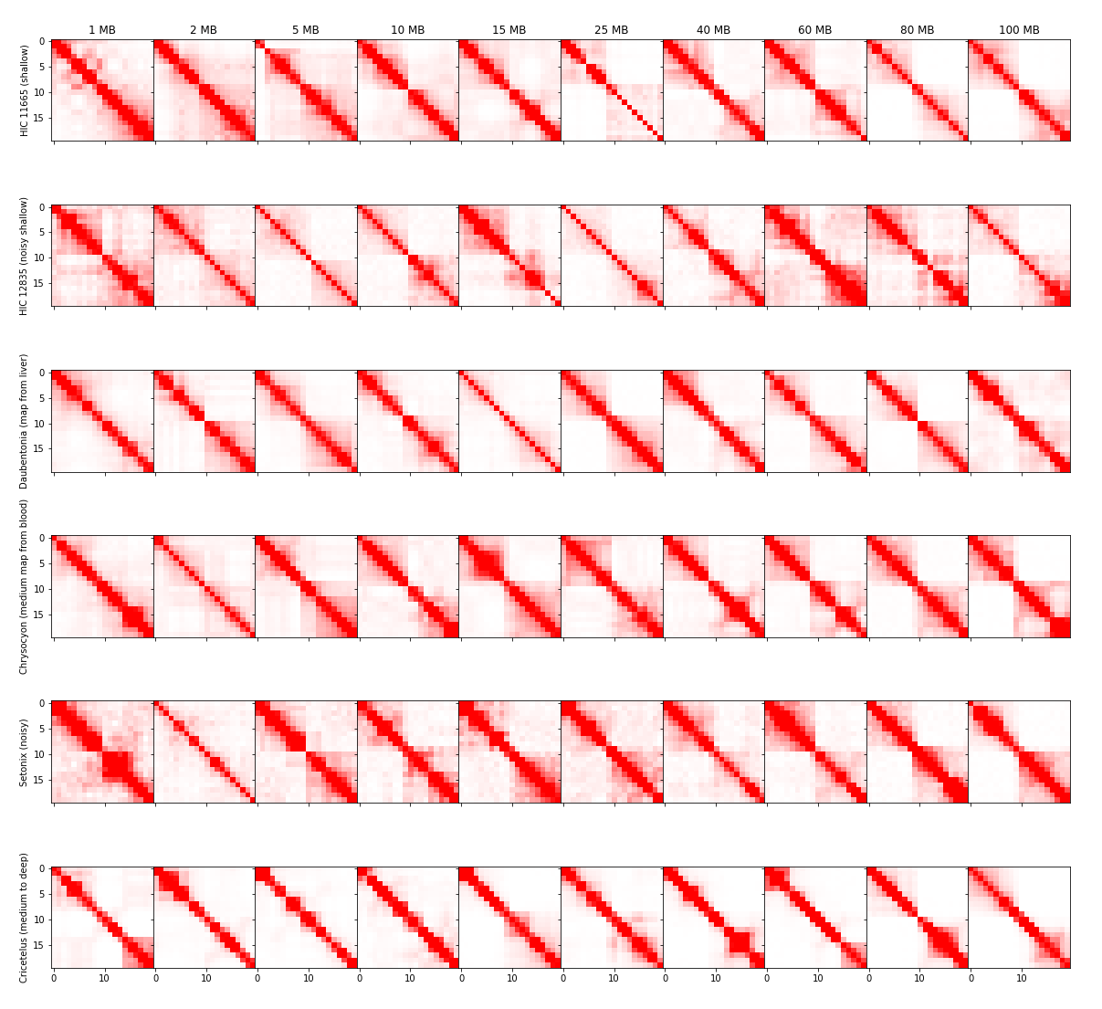
500 KB, 90% Centile, 20 by 20

Slide 16
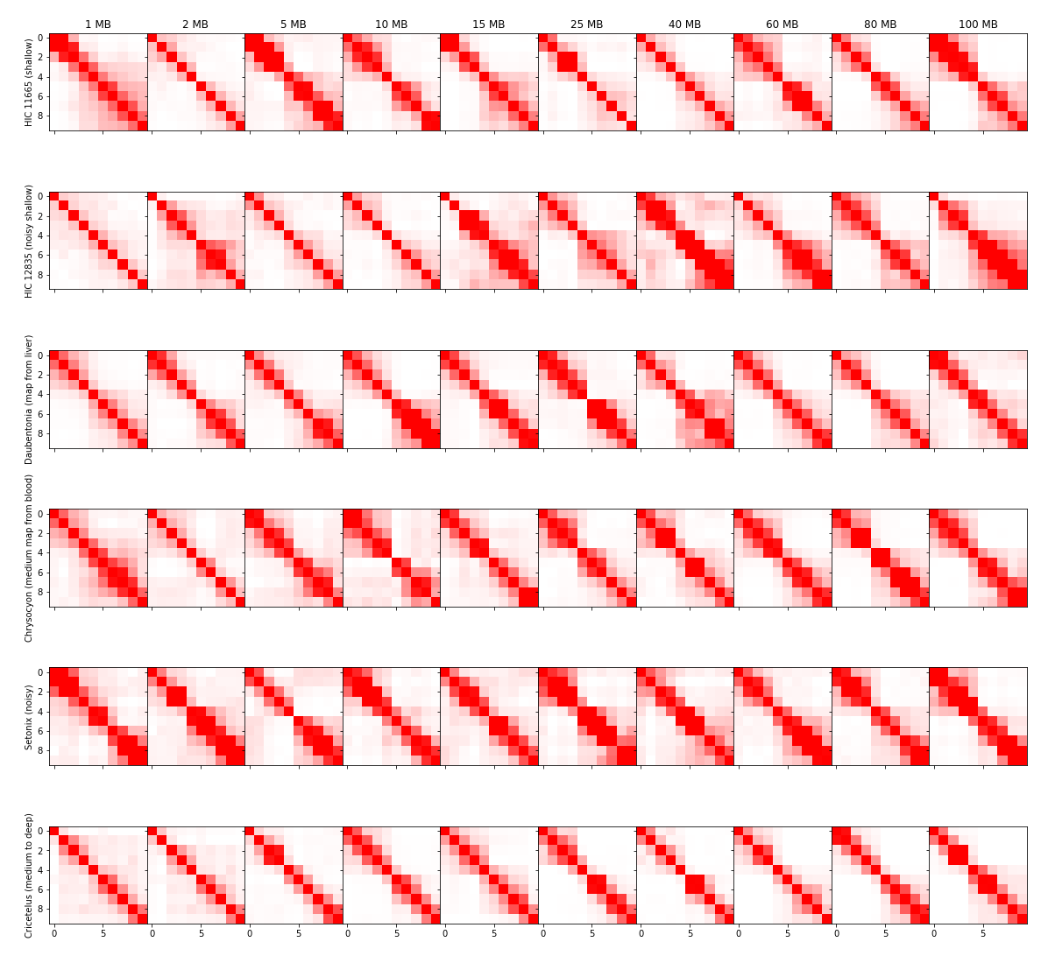
1 MB, 90% Centile, 10 by 10

Slide 17
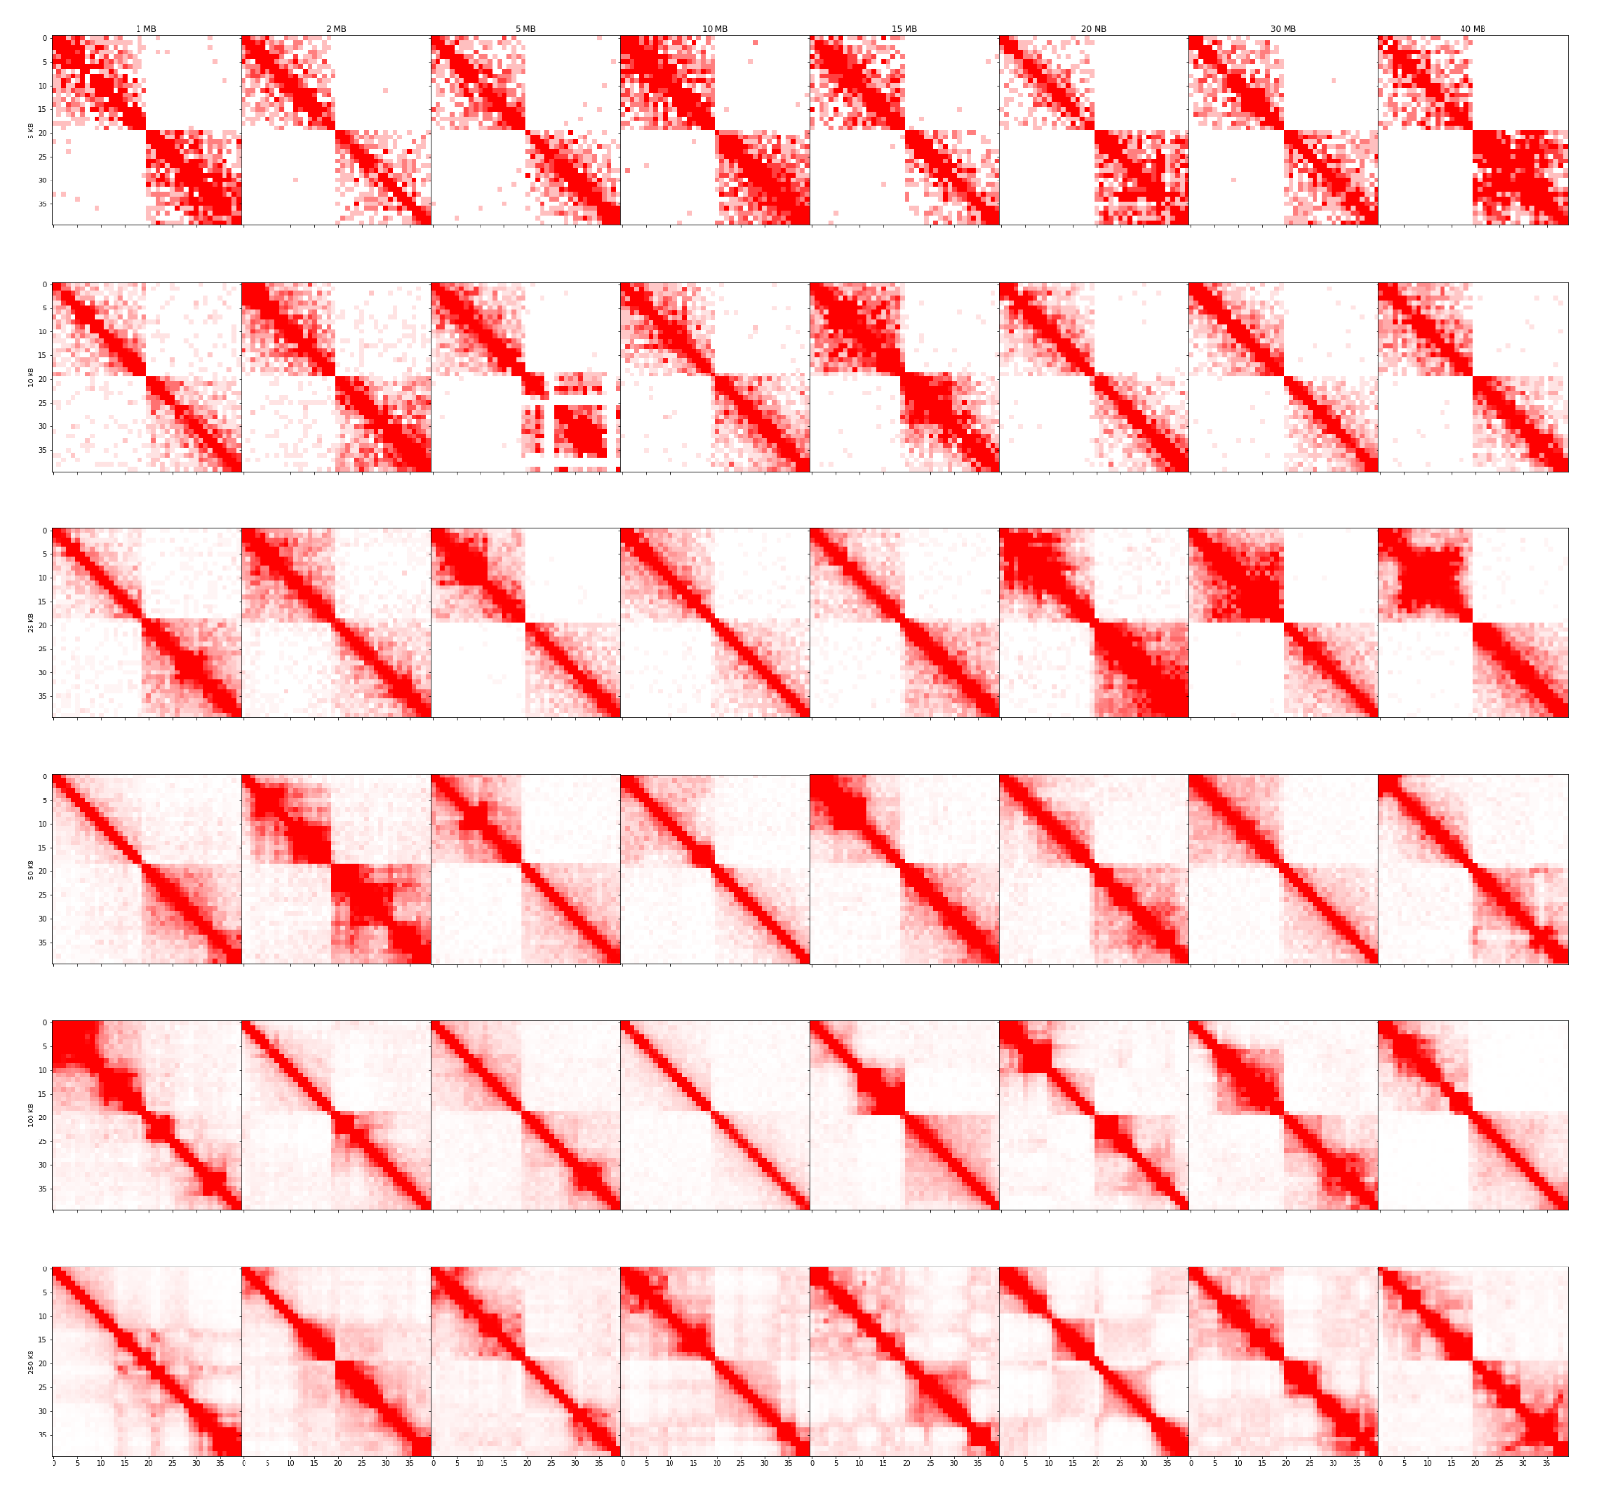
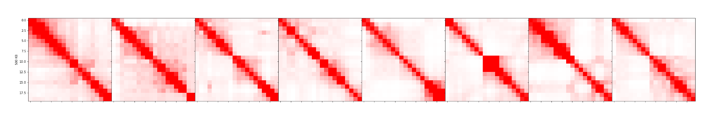
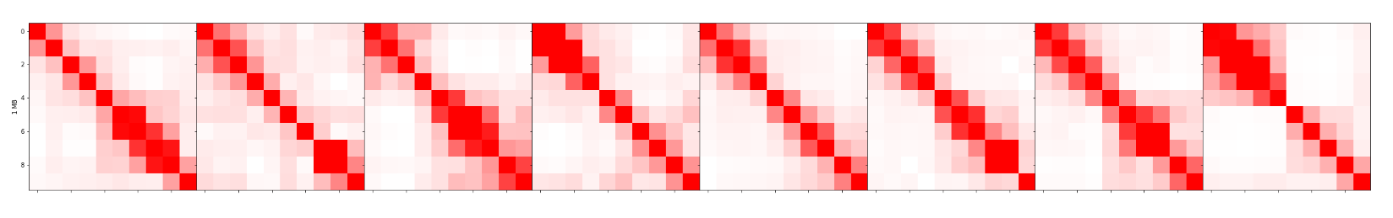
Test Set (Horse), 90% Centile

Slide 18
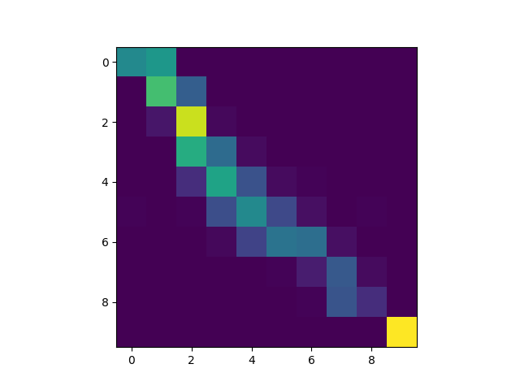
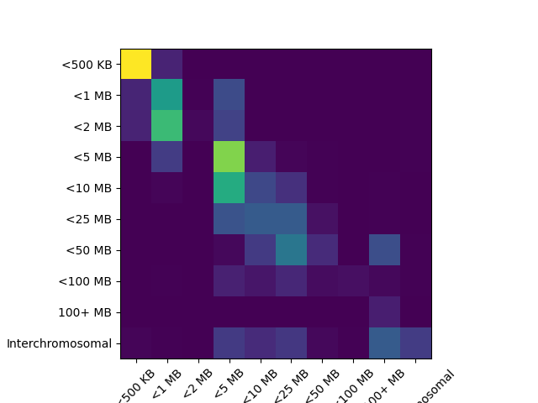

Slide 19
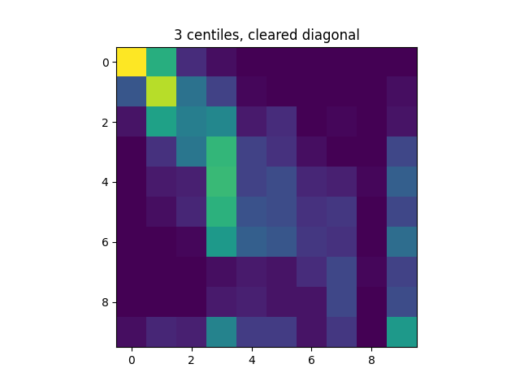
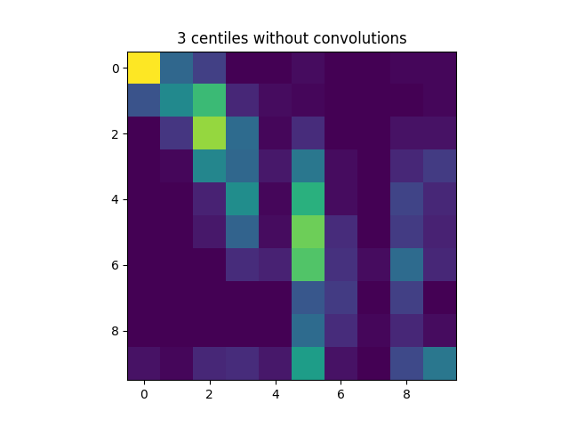
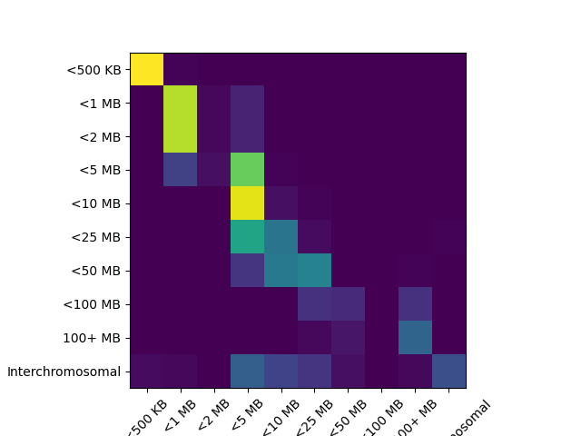
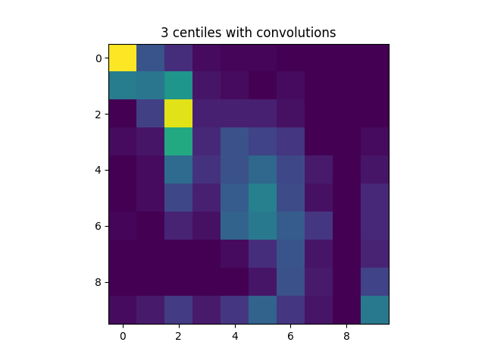
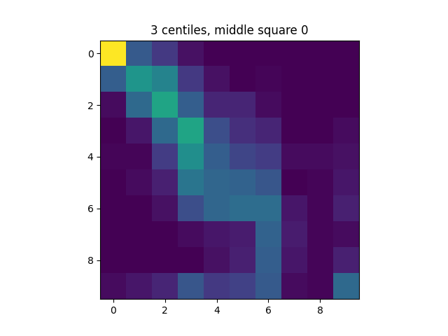
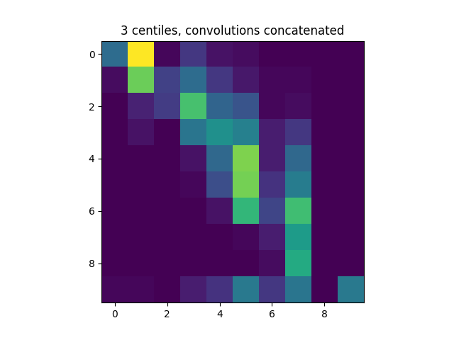

Slide 20
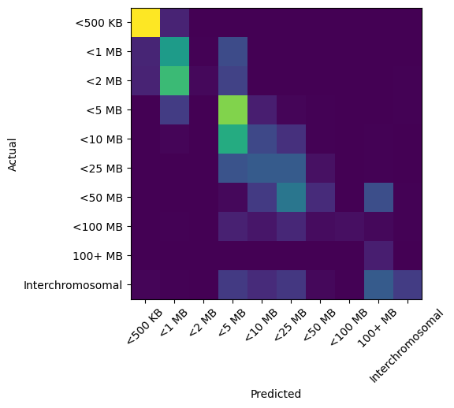

Slide 21
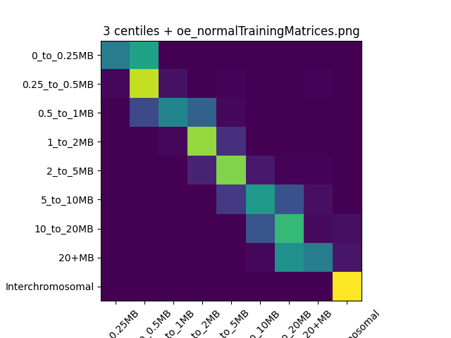
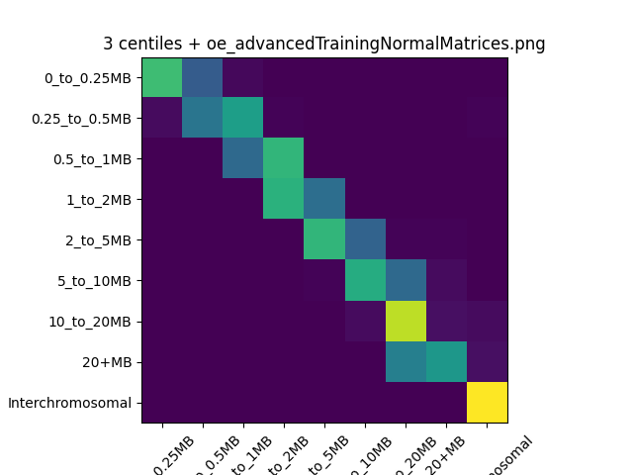
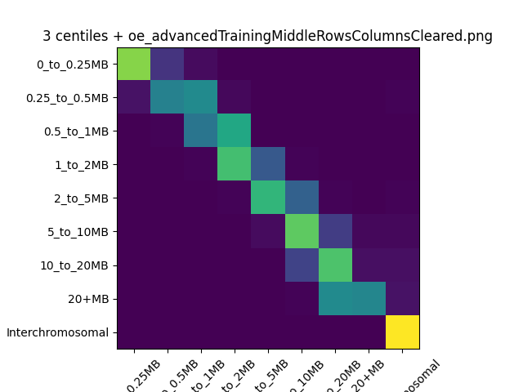


Slide 22
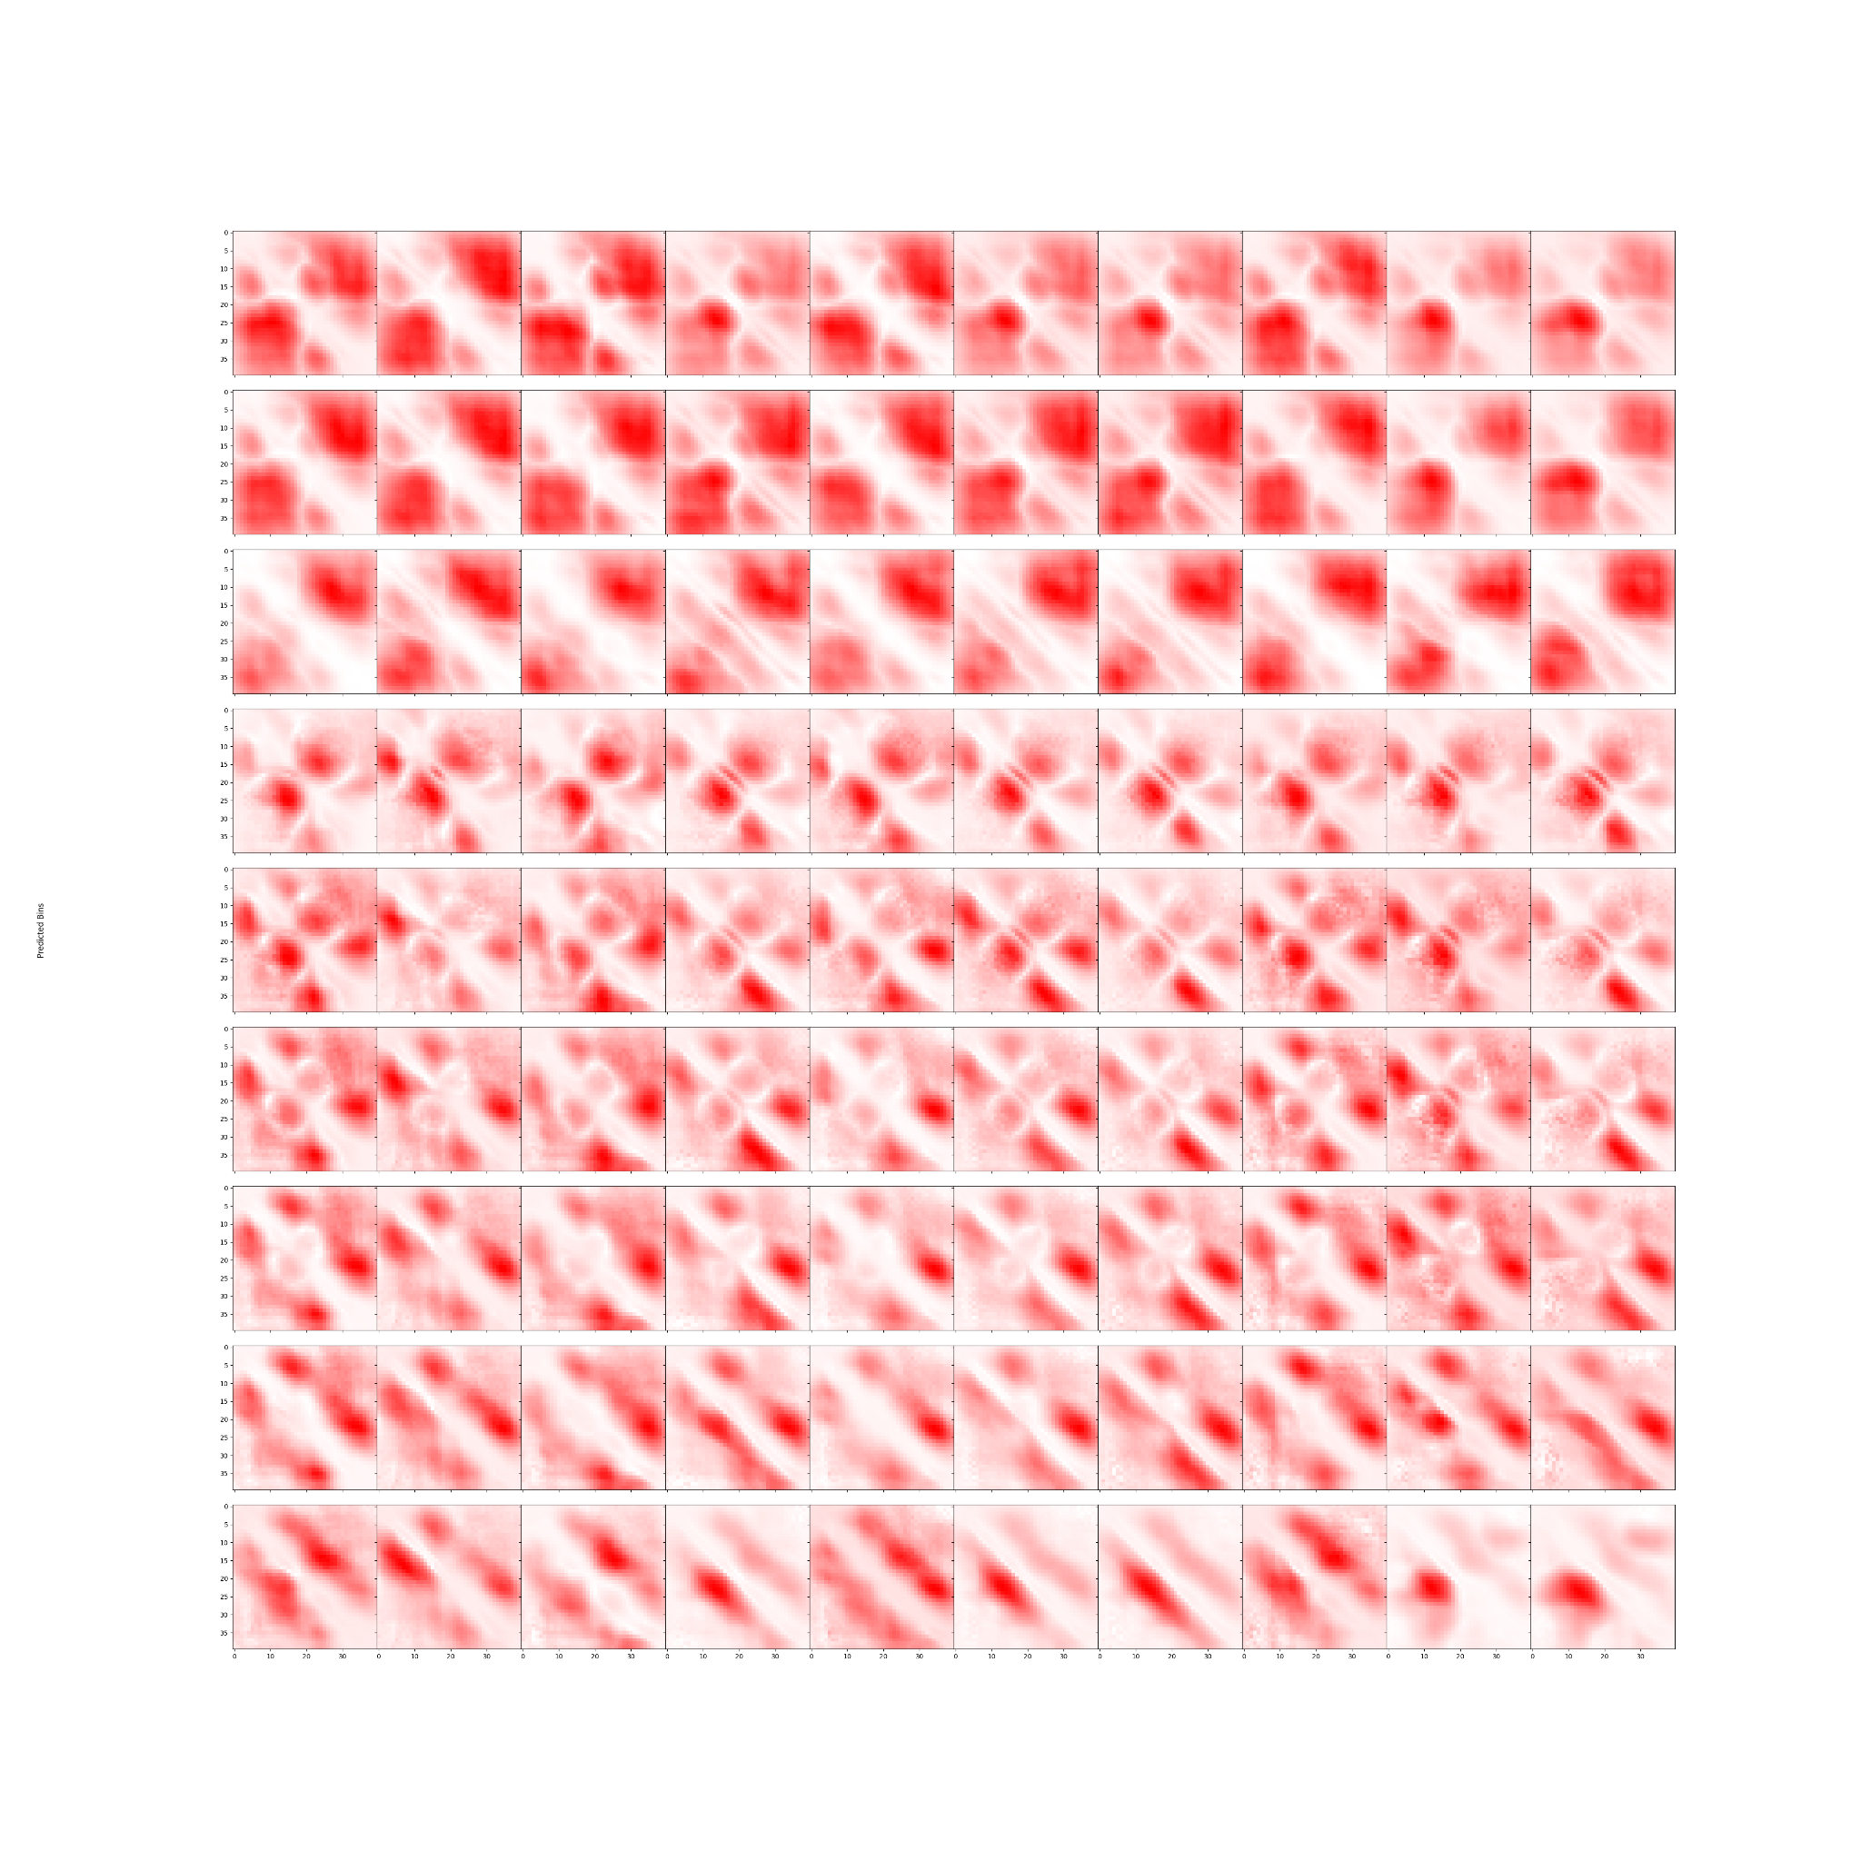

Slide 23
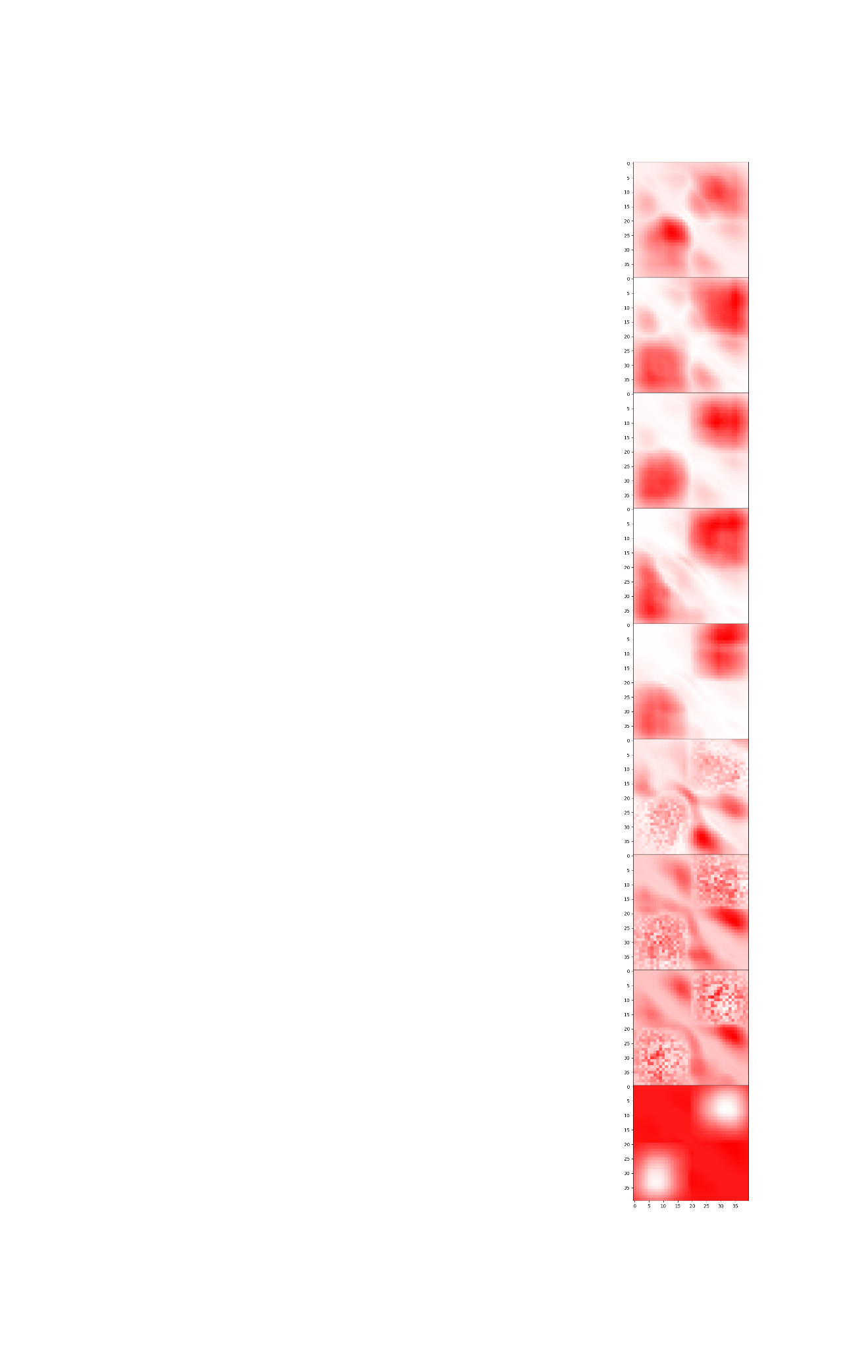

Slide 24
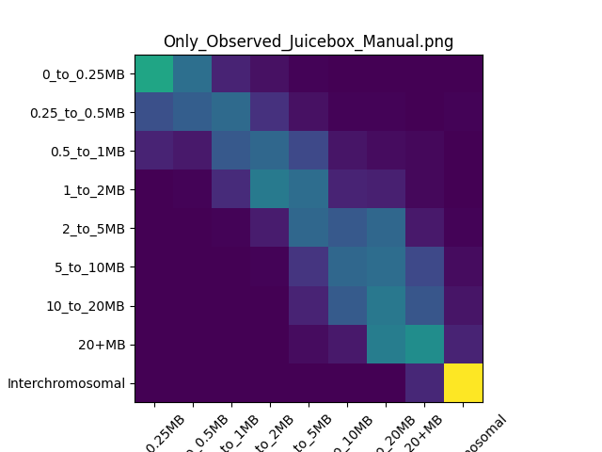
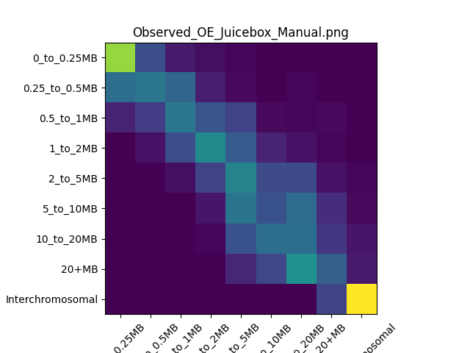

Slide 25
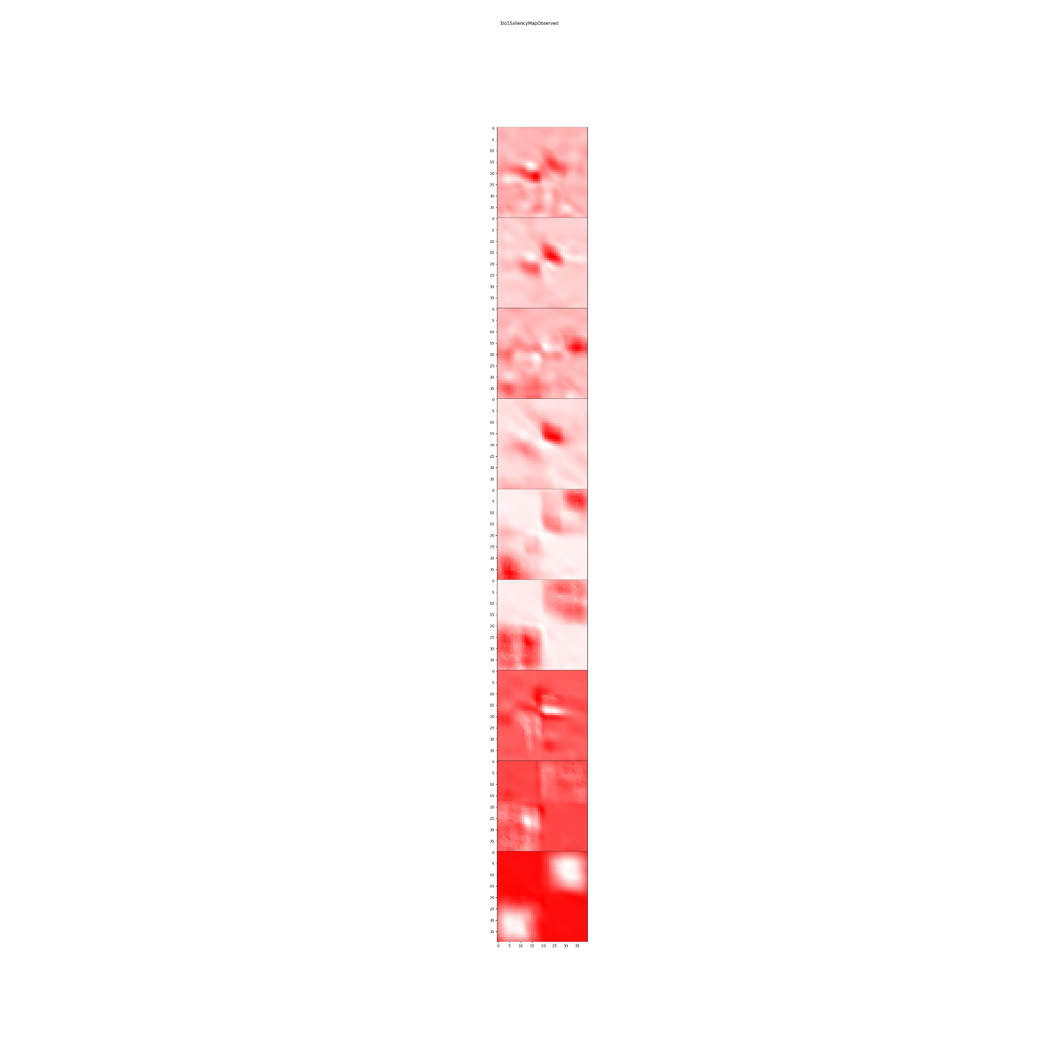
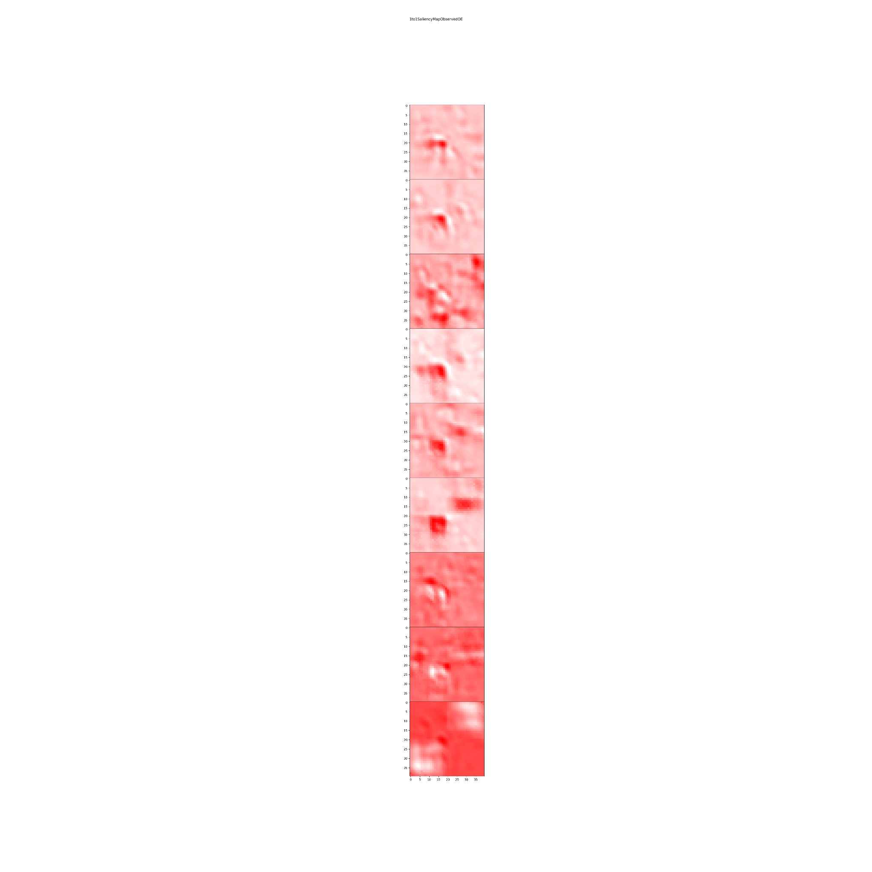
Observed
Observed + OE

Slide 26
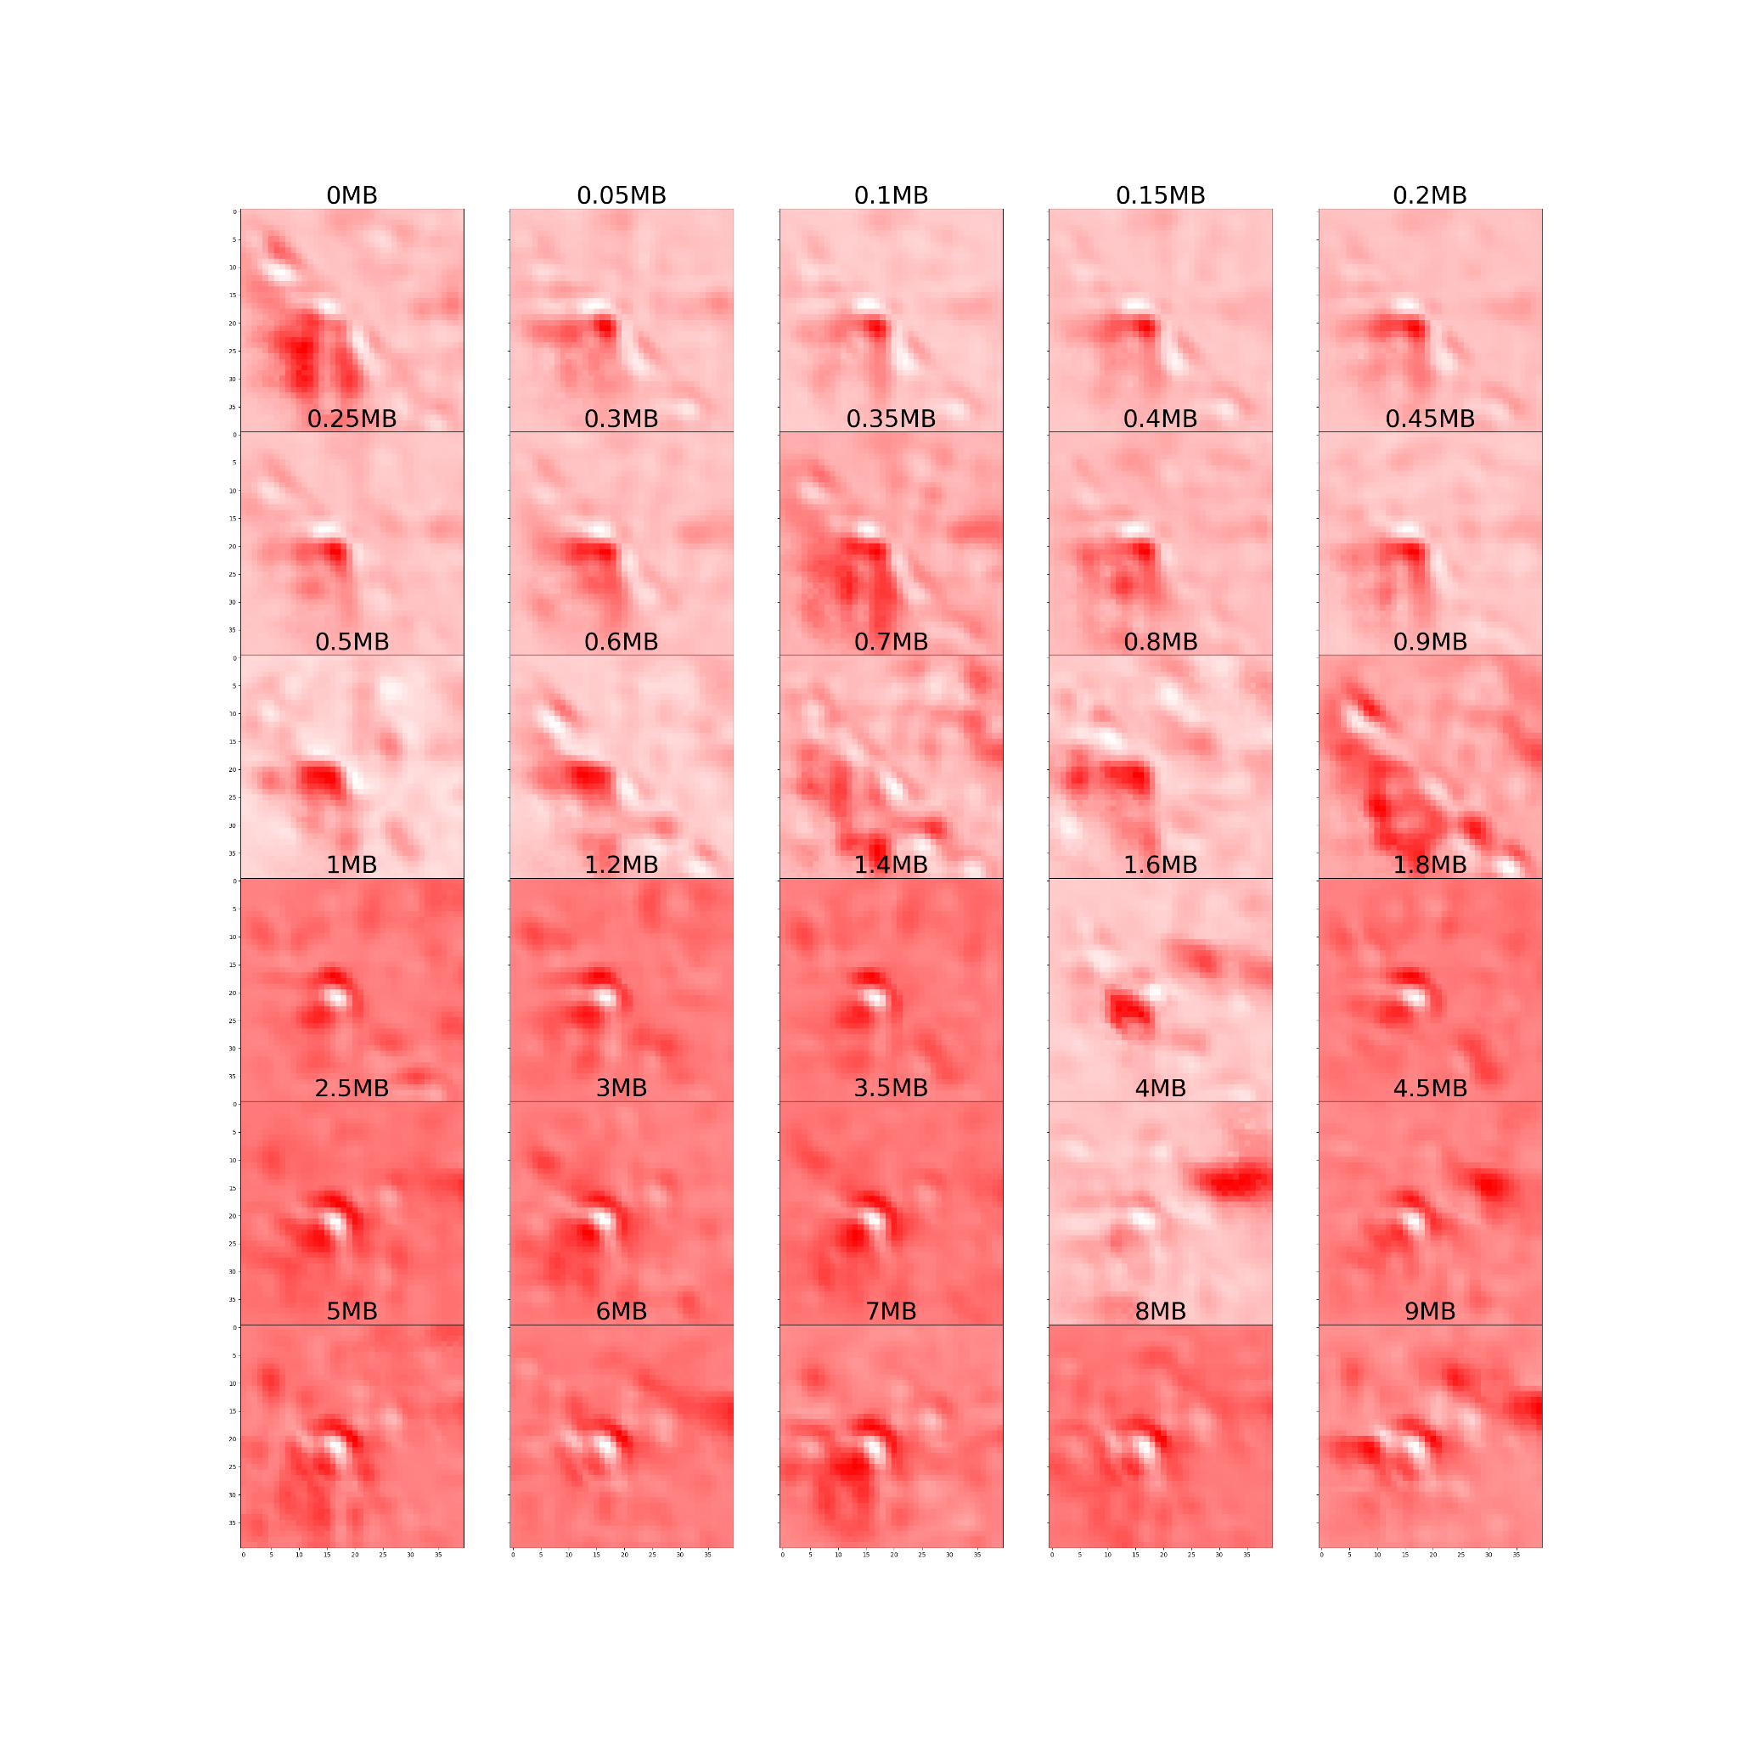

Slide 27


Slide 28


Just observed saliency map
Observed and OE saliency map

Slide 29


Slide 30


Slide 31


Slide 32


Slide 33


Slide 34


Slide 35

Interchromosomal

Slide 36

0 to 100 MB

Slide 37










Slide 38

0 to 1 MB

Slide 39










Slide 40
379
Gaussian Kernel
Upsampled

Slide 41


Predictions (Original):
0.00992198 0.00542266 0.02033059 0.02416419 0.10392095 0.10971395
0.16390683 0.28802025 0.27459872
Predictions (Blurred):
0.0219219 0.01642221 0.03813212 0.03382144 0.06846677 0.07699791
0.11998648 0.21389993 0.41035125

Slide 42

Predictions (Original):
[0.00992198 0.00542266 0.02033059 0.02416419 0.10392095 0.10971395
0.16390683 0.28802025 0.27459872
Predictions (Upsampled):
0.00090837 0.00036081 0.00141406 0.00268795 0.01584844 0.10466368 0.2586081 0.5057071 0.10980161

Slide 43
380
Gaussian Kernel
Upsampled

Slide 44


Predictions (Original):
0.05915337 0.02650597 0.05634913 0.05933205 0.03846229 0.04185342
0.0234025 0.34043628 0.35450494
Predictions (Blurred):
0.01832821 0.00802022 0.01869492 0.01675574 0.01066515 0.01729613
0.01467696 0.3094877 0.58607495

Slide 45

Predictions (Original):
0.05915337 0.02650597 0.05634913 0.05933205 0.03846229 0.04185342
0.0234025 0.34043628 0.35450494
Predictions (Upsampled):
0.05008424 0.02578372 0.04805941 0.04607753 0.03235223
0.03112645 0.02143105 0.284712 0.46037334

Slide 46
381
Gaussian Kernel
Upsampled

Slide 47


Predictions (Original):
0.3508909 0.28881523 0.06432723 0.02675383 0.07532287 0.03130301
0.05513702 0.05848685 0.04896298
Predictions (Blurred):
0.3546379 0.31509238 0.08887842 0.02689872 0.04750459 0.01973085
0.03509964 0.0436587 0.06849886

Slide 48

Predictions (Original):
0.3508909 0.28881523 0.06432723 0.02675383 0.07532287 0.03130301
0.05513702 0.05848685 0.04896298
Predictions (Upsampled):
0.2612917 0.26784953 0.13354193 0.07231256 0.06678287 0.04506663 0.05698103 0.03378748 0.06238629

Slide 49





Slide 50
Gaussian Blurred Model

Slide 51
Predictions (Original):
0.0061934 0.00075177 0.00020514 0.00018754 0.00644613 0.01627019
0.14433208 0.6525787 0.17303497
Predictions (Blurred):
0.0118753 0.00103245 0.00046707 0.00038924 0.00540983 0.01920066
0.1517731 0.5267776 0.28307468

Slide 52
Predictions (Original):
0.04559869 0.0194242 0.01090382 0.04654374 0.03302436 0.00520149
0.01009149 0.10851044 0.72070175
Predictions (Blurred):
0.00864105 0.00305848 0.00231518 0.01264987 0.01069247 0.0017465
0.00358775 0.11650005 0.84080863

Slide 53
Predictions (Original):
0.14123444 0.01526175 0.00218951 0.00022794 0.00175605 0.01115005
0.08733298 0.48573127 0.25511608
Predictions (Blurred):
0.06766594 0.00848831 0.00331058 0.00075799 0.003575 0.01648585
0.09893584 0.40940467 0.3913759

Slide 54
Cleared Diagonal Model

Slide 55
Predictions:
0.00001355 0.00000892 0.00000436 0.00000493 0.00053834 0.0148522
0.1292505 0.31647378 0.5388534

Slide 56
Predictions:
0.00029296 0.00057918 0.00009893 0.00219867 0.00041655 0.00039607
0.00032368 0.05969522 0.93599874

Slide 57
Predictions:
0.64128554 0.2194558 0.00655784 0.00001953 0.00002748 0.00007048
0.00149763 0.12516403 0.00592169

Slide 58
Cleared Middle Rows/Columns Model

Slide 59
Predictions:
0.00000644 0.0000091 0.00001336 0.00012443 0.00050812 0.01206461
0.0614772 0.87741256 0.04838423

Slide 60
Predictions:
0.00124284 0.00231742 0.00207265 0.00503652 0.00171453 0.00107926
0.00273813 0.12170891 0.8620897

Slide 61
Predictions:
0.03601275 0.00690611 0.00218324 0.00618408 0.00257557 0.04153201
0.14310938 0.3993844 0.36211246

Slide 62


Gaussian Model on 379 (Normal then Blurred)

Slide 63


Gaussian Model on 380 (Normal then Blurred)

Slide 64


Gaussian Model on 381 (Normal then Blurred)

Slide 65

Clear Diagonals on 379 (Normal then Cleared)

Slide 66

Clear Diagonals on 380 (Normal then Cleared)

Slide 67

Clear Diagonals on 381 (Normal then Cleared)

Slide 68

Add Random Noise on 379 (Normal then Noisy)

Slide 69

Add Random Noise on 380 (Normal then Noisy)

Slide 70

Add Random Noise on 381 (Normal then Noisy)

Slide 71





Slide 72


Slide 73


Slide 74


Slide 75


Slide 76


Slide 77


Slide 78


Slide 79


Slide 82


Slide 83


Slide 84


Slide 85


Slide 86


Slide 87


